Slide 1

Optimizing Decision-Making for MakeMyTrip Stakeholders
Insights into User Behaviors, Booking Trends, and Service Performance
Presented by – Mohd Fahad

Slide 2
Ask
Prepare
Process
Analyze
Share
ACT
Ask- Set key Question to answer from Analysis.
Prepare- Source the synthetic data from ChatGPT.
Process- Checked the Data For error and Cleaned it.
Analyze- Analyzed the data to get answer to question from ask phase.
Share- Created visualization im PowerBi and Quries for the same in MySql.
Act- Write insights and Recomendations

Slide 3
ASK
What are the trends in user booking behavior for MakeMyTrip services (flights, hotels, etc.)?
How can these trends help MakeMyTrip stakeholders optimize decision-making and improve business outcomes?
3.What is the age, gender, and regional distribution of MakeMyTrip users?
4.Which regions contribute the most to bookings?
5.Are there specific times of the year when users book the most flights or hotels?
6.What is the average lead time (days between booking and travel date) for flights and hotels?
7.Which destinations are the most popular among users?
8.What is the average rating of hotels booked on MakeMyTrip?
How does flight seat availability vary across regions and seasons?
9.What are the price trends for flights and hotels over time?
10.How do cancellations impact revenue by user type and booking type?
11.Which booking types (flights, hotels, packages) generate the most revenue?
12.How many users are repeat customers?
13.What is the average spend per repeat user compared to one-time users?
14.How does user loyalty vary across different demographics?
15. What percentage of user reviews are positive, negative, or neutral?
16.How do review sentiments correlate with service ratings?

Slide 4
Prepared
In the prepare phase, I did the following:
Created Synthetic data of MakeMyTrip from ChatGPT and downloaded the data in Zip file format.
I discovered some of the limitations of the data set, which were:
The dataset was only on 1000 users
The timeframe for the data collected was of two years.
Some parts of the dataset were incomplete.

Slide 5
PROCESS
This featured extensive data cleaning and wrangling. During this phase, these were the actions I performed:
Users: Phone numbers normalized by removing non-numeric characters.
Gender entries standardized (e.g., capitalized for consistency).
Hotels: Amenities list cleaned and split into individual items.
Missing Price Per Night values replaced with the median price.
Flights: Converted Departure Time and Arrival Time into time format.
Missing Price values filled with the median price.
Bookings: Null values in Source City and Destination City replaced with "N/A".
Travel Duration calculated as the difference between Travel Date and Booking Date.
Total Revenue column added (currently identical to Amount).
Reviews: Missing reviews replaced with "No Review".
Missing ratings filled with the median rating.
Uploaded the cleaned data to MySQL and Power BI.

Slide 6
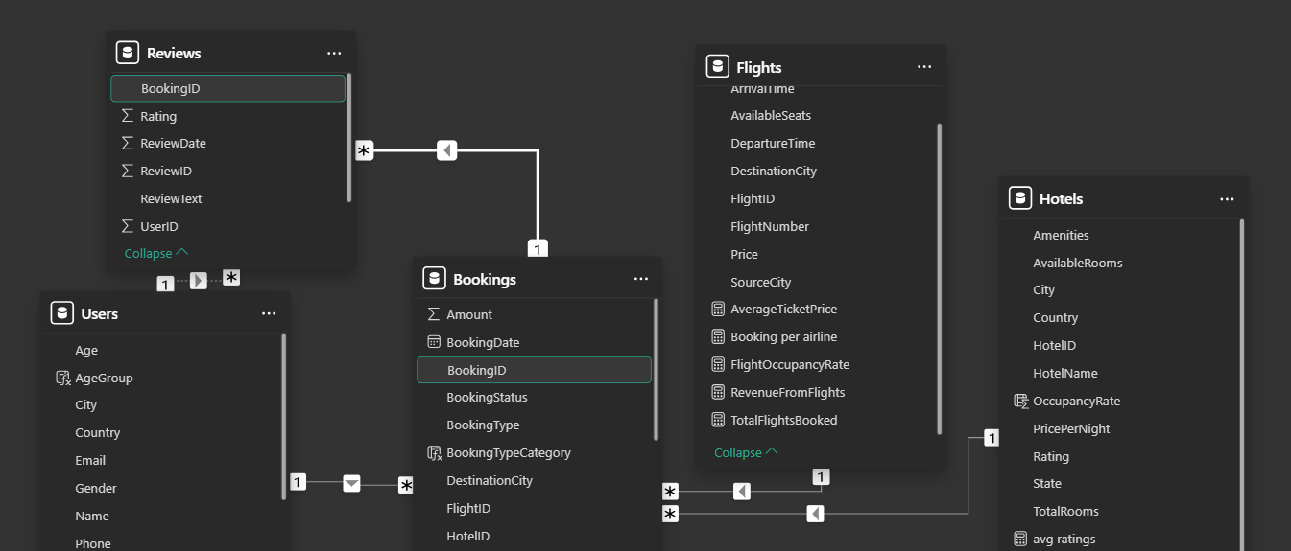
Established relationships between tables using primary keys
Users ↔ Bookings: Link via UserID.
Hotels ↔ Bookings: Link via HotelID.
Flights ↔ Bookings: Link via FlightID.
Reviews ↔ Bookings: Link via BookingID.

Slide 7
Dashboards Overviews
User Demographics Dashboard: Analyzing the age, gender, and geographical distribution of users.
Hotel Performance Dashboard: Tracking hotel ratings, room availability, and pricing trends.
Flight Analytics Dashboard: Monitoring flight prices, seat availability, and popular routes.
Booking Trends Dashboard: Visualize booking patterns over time for hotels and flights.
Revenue Insights Dashboard: Assess revenue trends by booking type, user demographics, and regions.
Cancellation Insights Dashboard: Identify reasons and trends in booking cancellations.
User Retention Dashboard: Track repeat bookings, average spend per user, and user loyalty metrics.
Review Sentiment Analysis Dashboard: Provide insights into user feedback and sentiment trends.

Slide 8
Objective
Goal:
-------Provide actionable insights into user behaviors, booking trends, and service performance.
-------Enable better resource allocation, improved user satisfaction, and increased revenue.

Slide 9
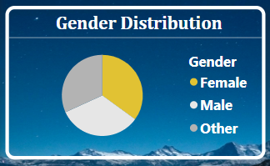
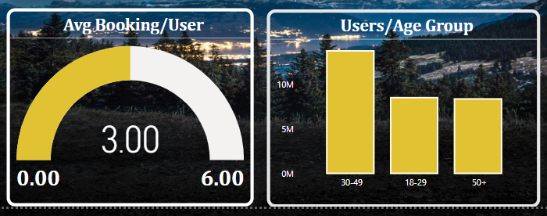
Key Metrics Overview
Analyze and Share
Total Users: 1000 (Active: 962)
Revenue/User: 31K
Gender Distribution
Male 33.2%
Female & Others: Remaining percentage
Age Group Analysis:
Major bookings: 18-29 years

Slide 10
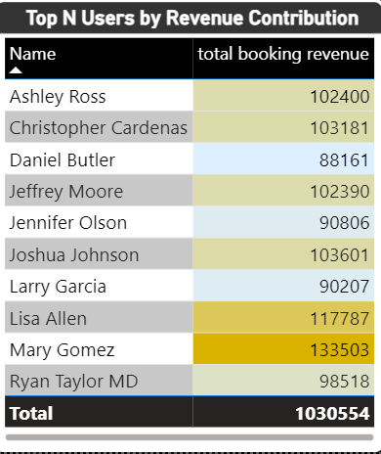
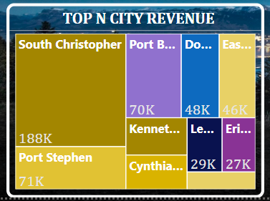
User Demographics and Revenue
Top Users by Revenue Contribution: (E.g., Lisa Allen - 117K, Mary Gomez - 133K)
Top City Revenue Distribution
----Top Cities: Christopher Port ($188K), Stephen Port ($71K)
Retention Trends
---Average bookings/user: 3.00

Slide 11
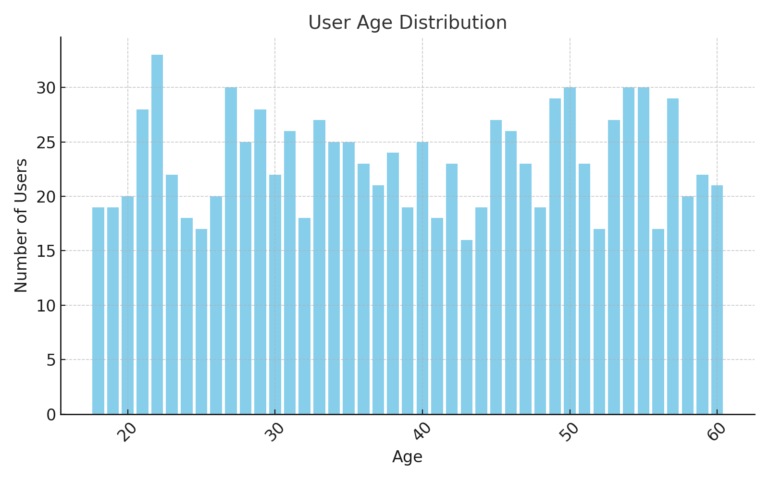

Slide 12
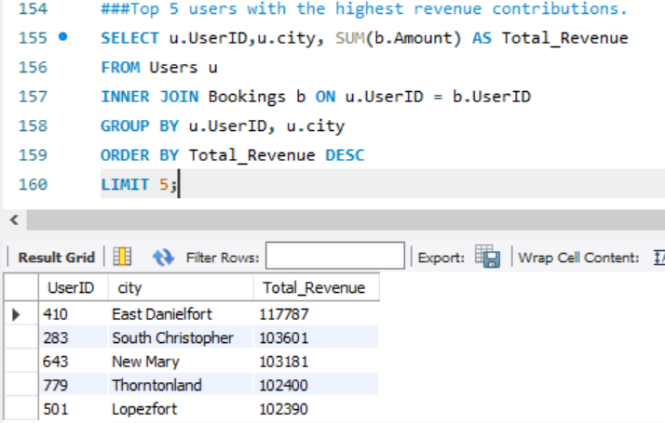
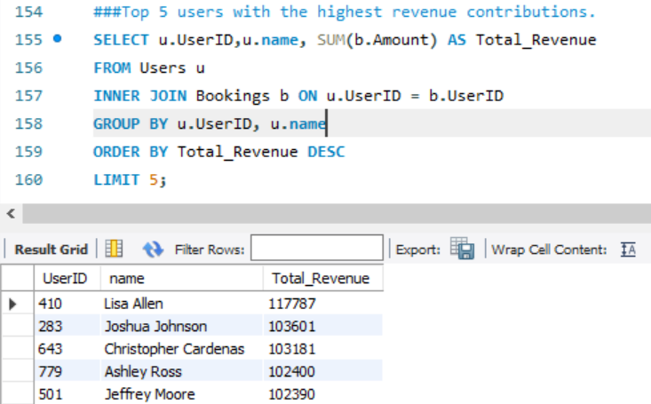

Slide 13
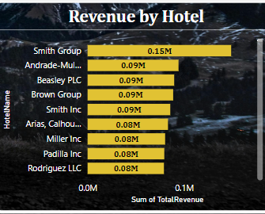
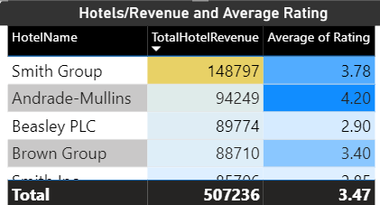
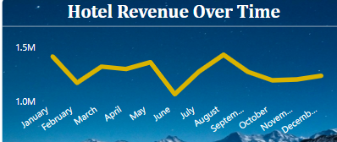
Hotel Booking Trends
Hotel Revenue Breakdown:
----- Top Performers: Smith Group ($148K), Andrade-Mullins ($94K)
Average Hotel Rating: 3.73
------ Monthly Trends: Revenue peaks and occupancy insights.

Slide 14
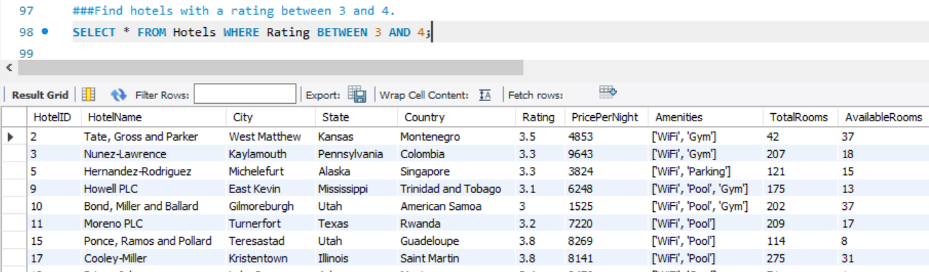
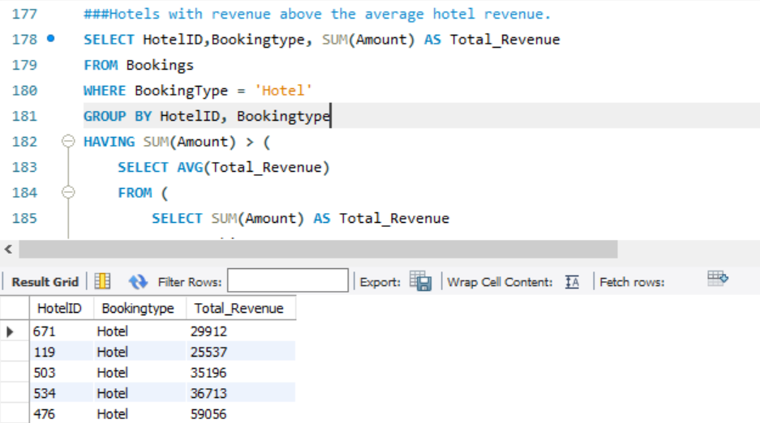
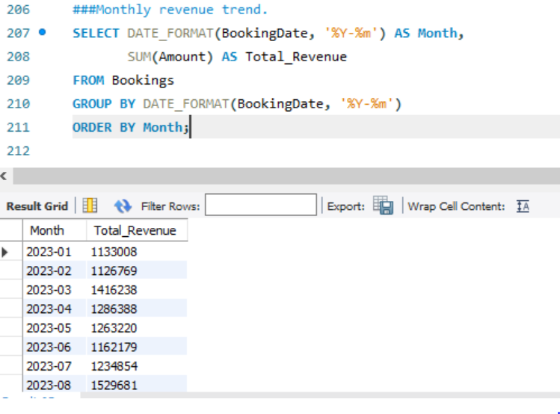

Slide 15
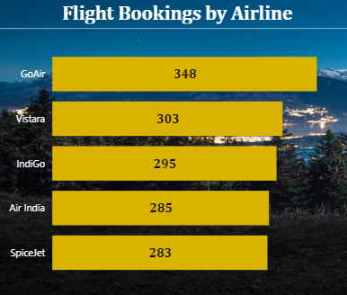
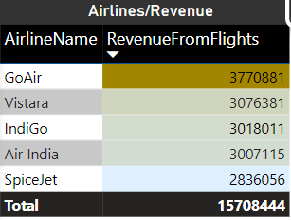
Flight Booking Analytics
Total Flight Revenue: $16M
Airline Performance:
---- GoAir ($377K), Vistara ($307K), IndiGo ($301K)
Key Insights:
---- Avg. Ticket Price: $10.38K
---- Total Seats: 1500

Slide 16
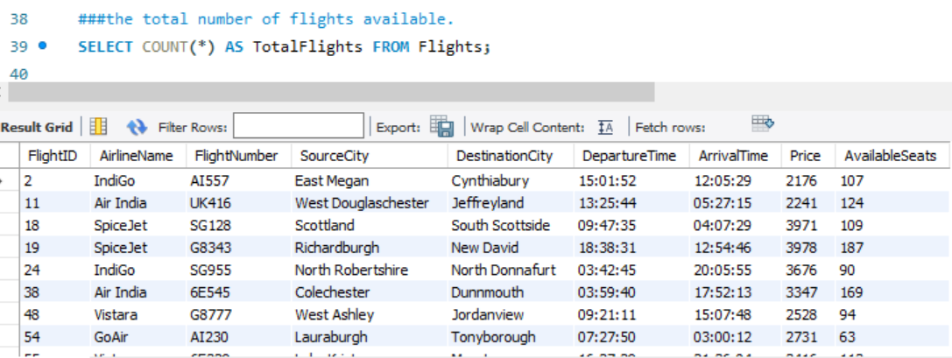
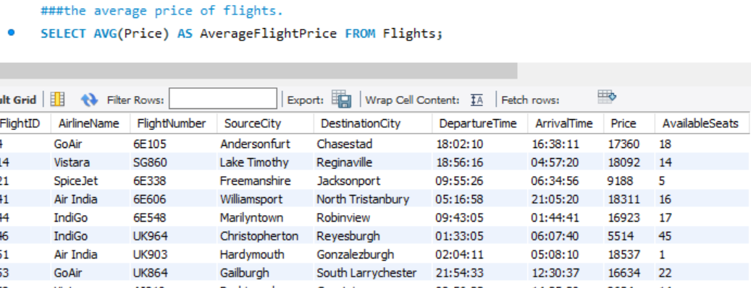
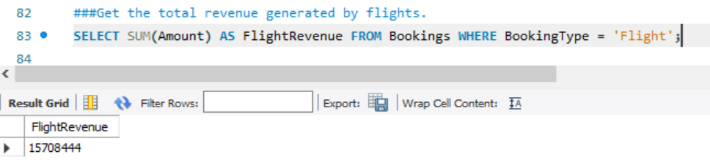

Slide 17
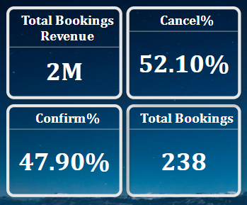
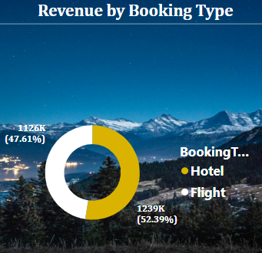
Booking Trends and Patterns
Revenue by Booking Type
---- Flights: $16M
----Hotels: $15M
Monthly Booking Growth:
----Booking status insights: Confirmation (47.9%), Cancellations (52.1%)

Slide 18
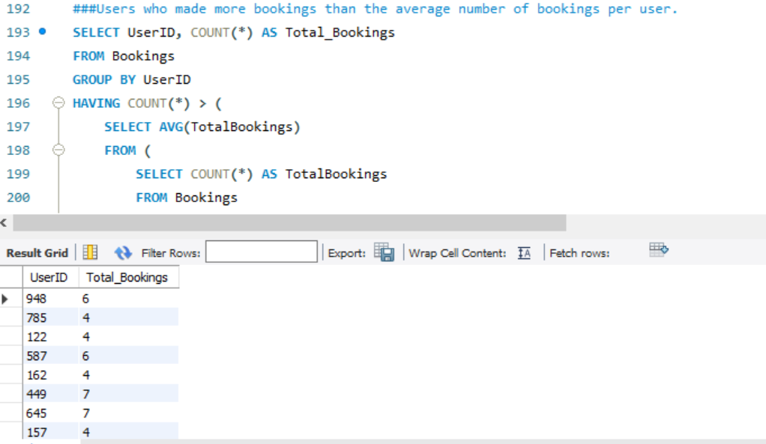
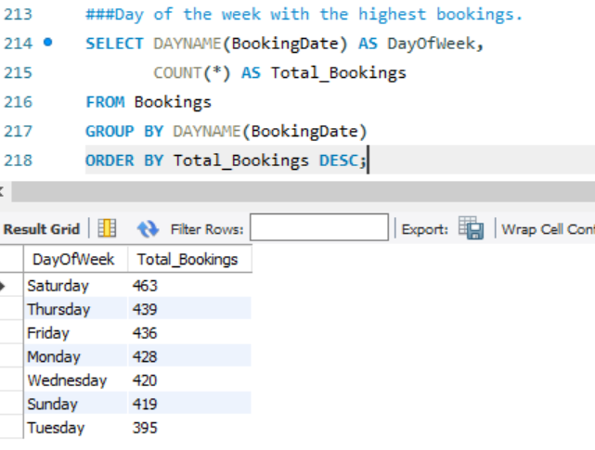

Slide 19
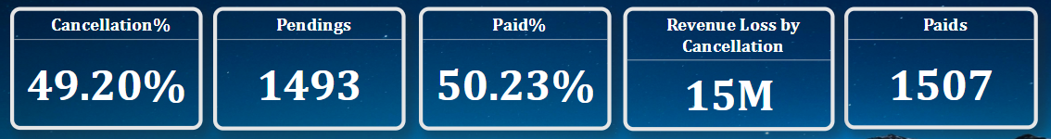
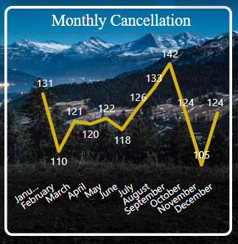
Impact of Cancellations
Revenue Loss Due to Cancellations: $15M
Key Metrics:
---- Paid Bookings: 1507
---- Pending Bookings: 1493

Slide 20
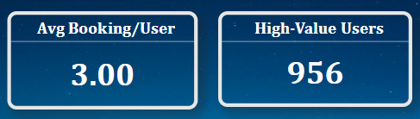
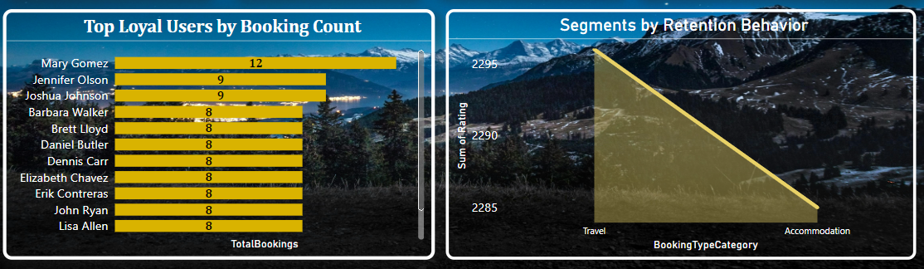
User Retentions

Slide 21
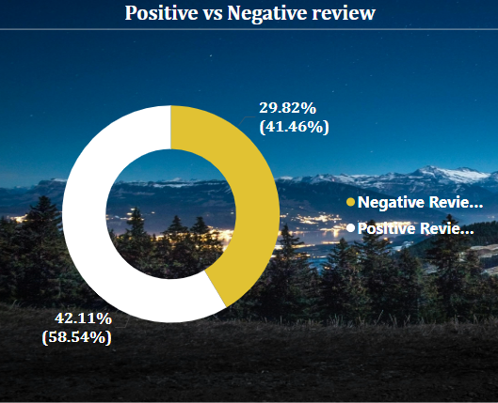
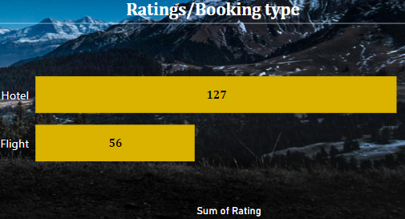
Customer Satisfaction
- Review Sentiment Analysis:
- Positive Reviews: 41.27%
- Negative Reviews: 58.54%
- Avg. Ratings: 3.05
- Ratings by Booking Type:
- Hotels and Flights comparison.

Slide 22
Conclusion & Recommendations
ACT
Insights for Stakeholders:
Focus on retention and engagement of high-value users.
Optimize resource allocation to top-performing cities and services.
Address cancellation and negative review patterns.
Action Plan:
Strengthen customer service for better reviews.
Enhance peak season strategies.
Call to Action
Conclude with specific, actionable steps for stakeholders
“Invest in customer service improvements to enhance review sentiments.”
Launch targeted campaigns for underperforming regions.”

